Slide 1
Approaches to Knowledge Representation

Slide 2
Approaches to Knowledge Representation
There are mainly four approaches to knowledge representation
Simple relational knowledge
Inheritable knowledge
Inferential knowledge
Procedural knowledge

Slide 3
Simple relational knowledge
It is the simplest way of storing facts which uses the relational method, and each fact about a set of the object is set out systematically in columns.
This approach of knowledge representation is famous in database systems where the relationship between different entities is represented.
This approach has little opportunity for inference.

Slide 4
Example
Player | Weight | Age
Player1 | 65 | 23
Player2 | 58 | 18
Player3 | 75 | 24

Slide 5
Inheritable knowledge
It prescribes a structure in which new objects are created which may inherit all or subset of attributes from existing objects.
In the inheritable knowledge approach, all data must be stored into a hierarchy of classes.
In this approach, objects and values are represented in Boxed nodes.
We use Arrows which point from objects to their values.

Slide 6
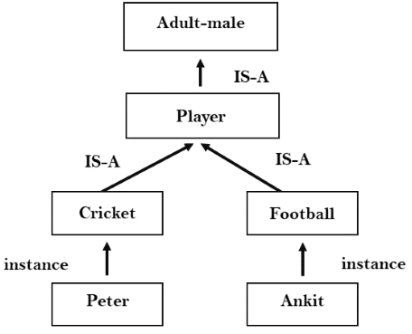
Example

Slide 7
Inferential knowledge
It is inferred from objects through relation among objects
This approach can be used to derive more facts.

Slide 8
Example
Let's suppose there are two statements:
Marcus is a man
All men are mortal Then it can represent as; man(Marcus) ∀x = man (x) ----------> mortal (x)s

Slide 9
Procedural knowledge
Procedural knowledge approach uses small programs and codes which describes how to do specific things, and how to proceed.
In this approach, one important rule is used which is If-Then rule.
In this knowledge, we can use various coding languages such as LISP language and Prolog language.
For example learning to ride a bicycle or learning the driving process.

Slide 10
Properties of Knowledge Representation
Whenever knowledge representation in AI is discussed, we discuss creating the knowledge representation system that can represent the various types of knowledge discussed above. This system must manifest certain properties that can help us in assessing the system.

Slide 11
1.Representational Adequacy
A major property of a knowledge representation system is that it is adequate and can make an AI system understand, i.e., represent all the knowledge required by it to deal with a particular field or domain.

Slide 12
2.Inferential Adequacy
The knowledge representation system is flexible enough to deal with the present knowledge to make way for newly possessed knowledge.

Slide 13
3.Inferential Efficiency
The representation system cannot accommodate new knowledge in the presence of the old knowledge, but it can add this knowledge efficiently and in a seamless manner.

Slide 14
4.Acquisitional Efficiency
The final property of the knowledge representation system will be its ability to gain new knowledge automatically, helping the AI to add to its current knowledge and consequently become increasingly smarter and productive.

Slide 15
Cycle of Knowledge Representation
Artificial Intelligent Systems usually consist of various components to display their intelligent behavior. Some of these components include:
Perception
Learning
Knowledge Representation & Reasoning
Planning
Execution

Slide 16
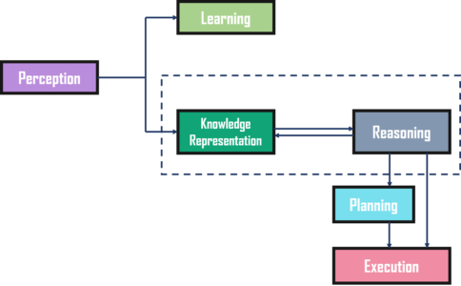
Cycle of Knowledge Representation

Slide 17
Perception Block
This will help the AI system gain information regarding its surroundings through various sensors, thus making the AI system familiar with its environment and helping it interact with it.
These senses can be in the form of typical structured data or other forms such as video, audio, text, time, temperature, or any other sensor-based input.

Slide 18
Learning Block
The knowledge gained will help the AI system to run the deep learning algorithms. These algorithms are written in the learning block, making the AI system transfer the necessary information from the perception block to the learning block for learning (training).

Slide 19
Knowledge and Reasoning Block
As mentioned earlier, we use the knowledge, and based on it, we reason and then take any decision. Thus, these two blocks are responsible for acting like humans go through all the knowledge data and find the relevant ones to be provided to the learning model whenever it is required.

Slide 20
Planning and Execution Block
These two blocks though independent, can work in tandem. These blocks take the information from the knowledge block and the reasoning block and, based on it, execute certain actions. Thus, knowledge representation is extremely useful for AI systems to work intelligently.

